Slide 1

2019·05
DATA MINING WQD7005
NAME: DENG QIAOYIN
NO.: WQD170071
INSTRUCTOR: PROFESOR MADYA DR. TEH YING WAH

Slide 2

Acquisition of data
02
Management of data
01
Table
of
Content
03
Processing of data
04
Interpretation of data
05
Communication
of insights of data
06
Provide recommendations

Slide 3
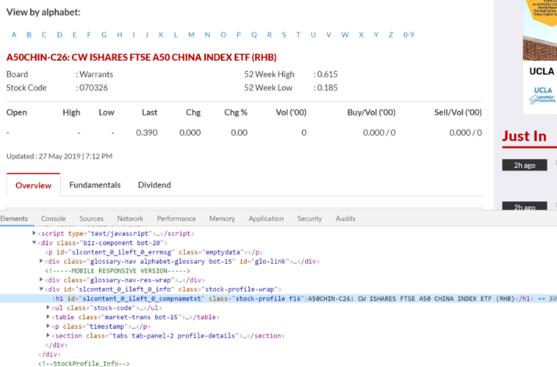
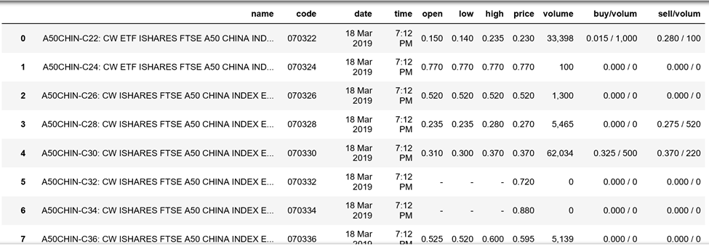
1
Milestone
ACQUISITION OF DATA
Stock price data
Data is crawl from the website theStarOnline
https://www.thestar.com.my/business/marketwatch/stock-list/?alphabet=A
The data is crawled using the Python package Selenium, and stock data is in alphabetical order.
There are around 1800 stocks, and we acquire data by each day’s closing price. Information includes Stock name, Stock code, Date, Time, Open price, Low price, High price, Closing price, Volumes, buy/volume, sell/volume.

Slide 4
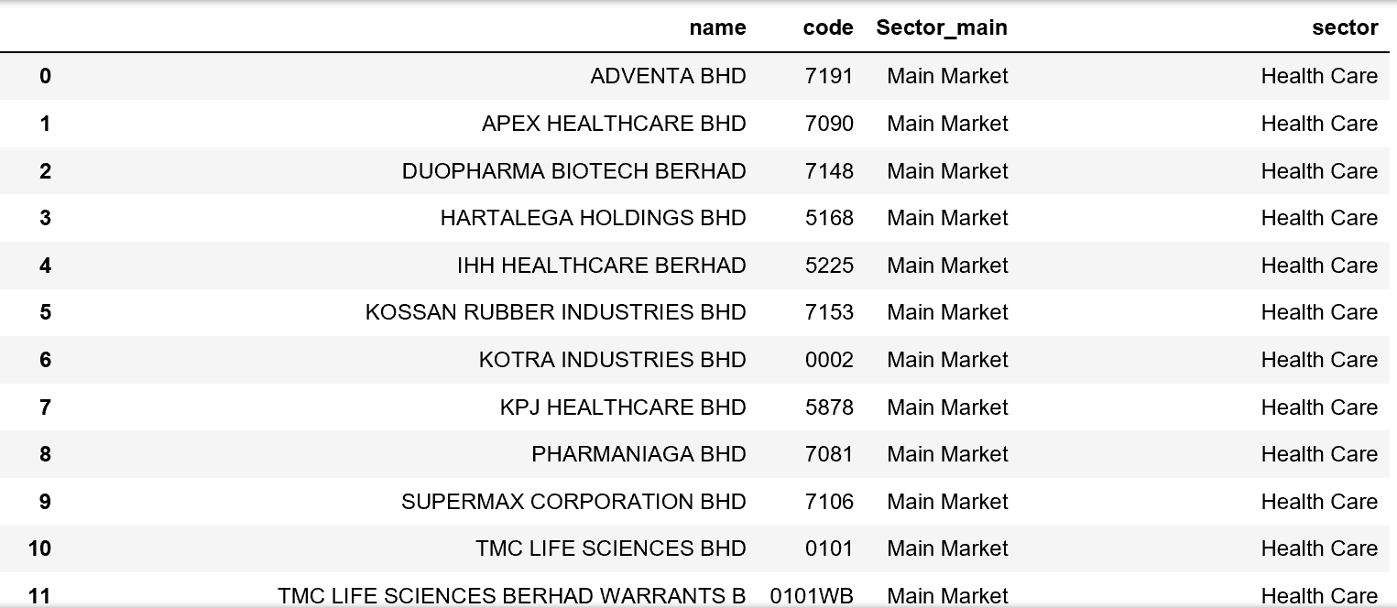
2
Milestone
MANAGEMENT OF DATA
Sector of stock
The sector of stock is crawl from the same website as the stock price data. This data can then merge with other sources.

Slide 5
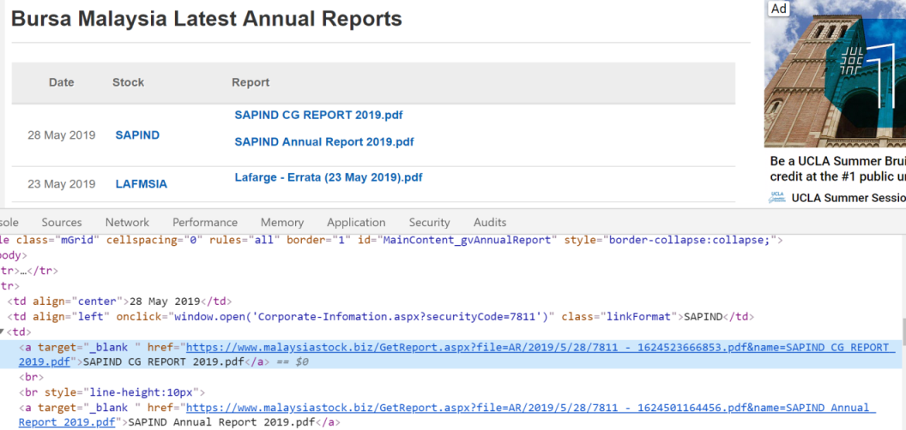
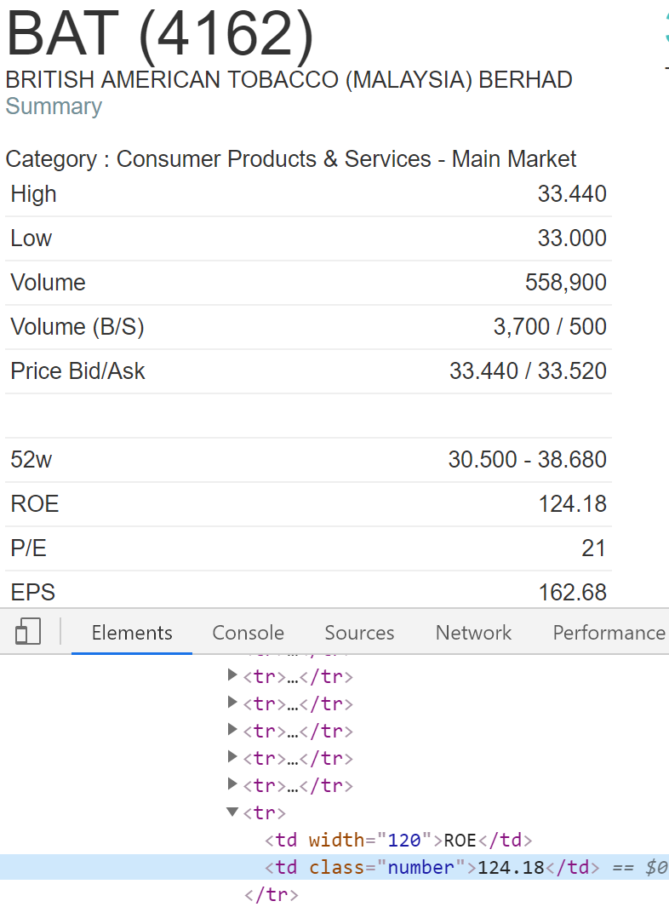
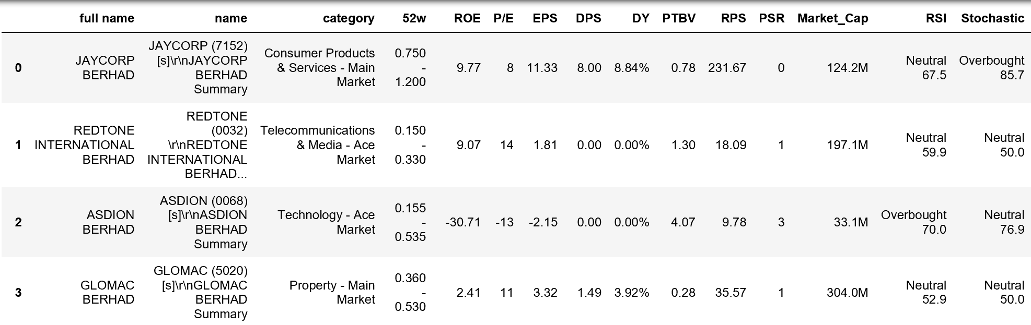
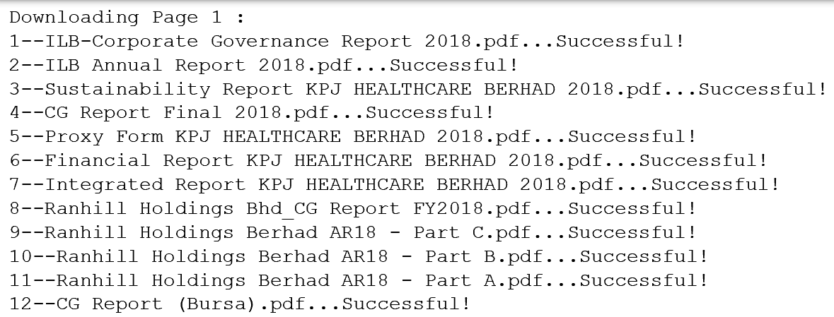
2
Milestone
MANAGEMENT OF DATA
Financial data
Financial report data
KLSE financial data
https://www.malaysiastock.biz/Annual-Report.aspx
https://www.klsescreener.com/v2/financial-reports

Slide 6
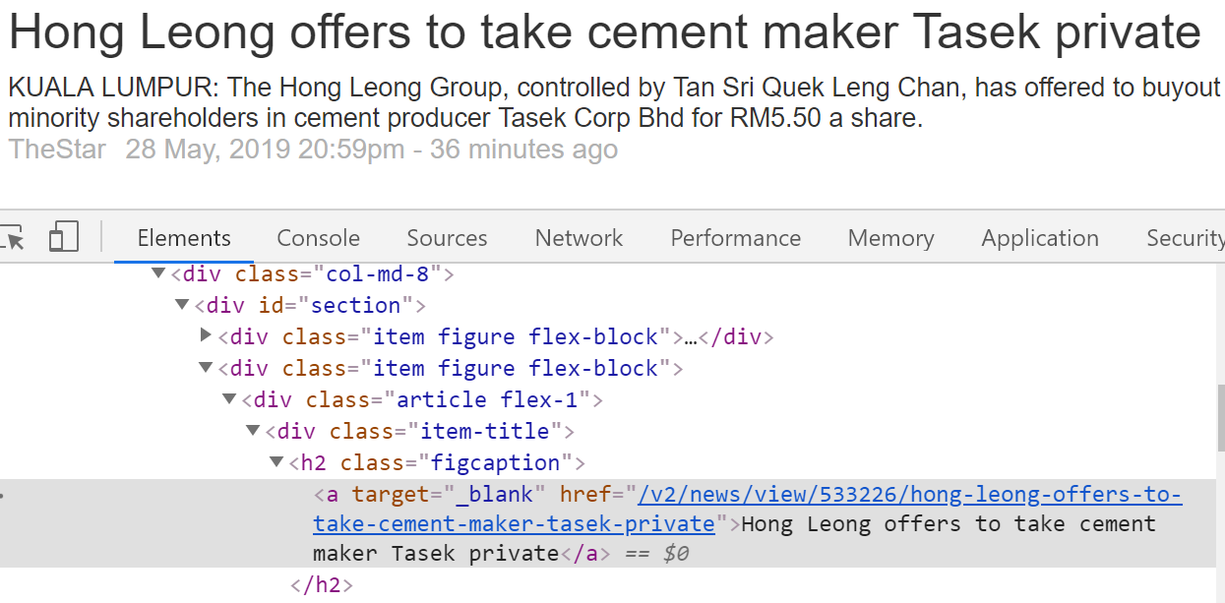
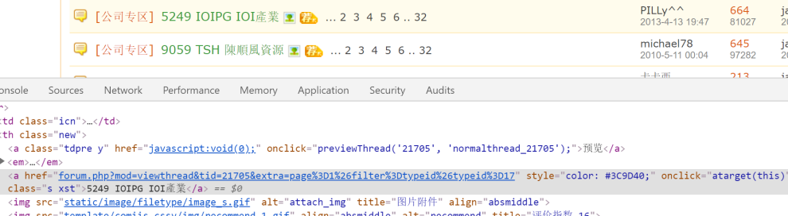
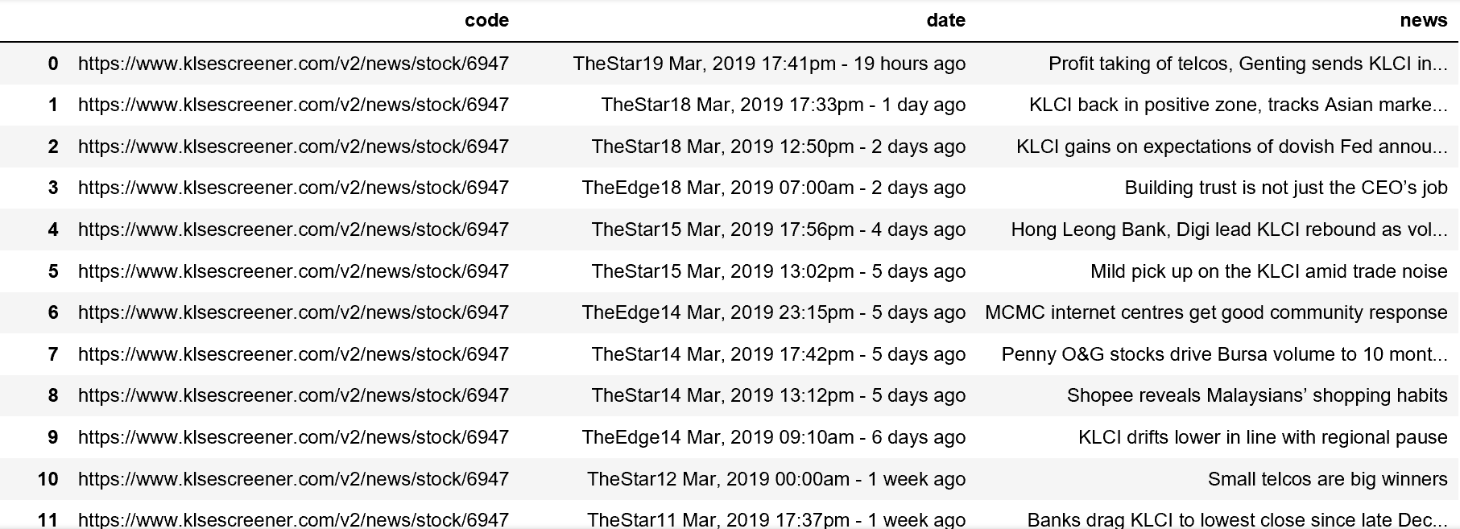
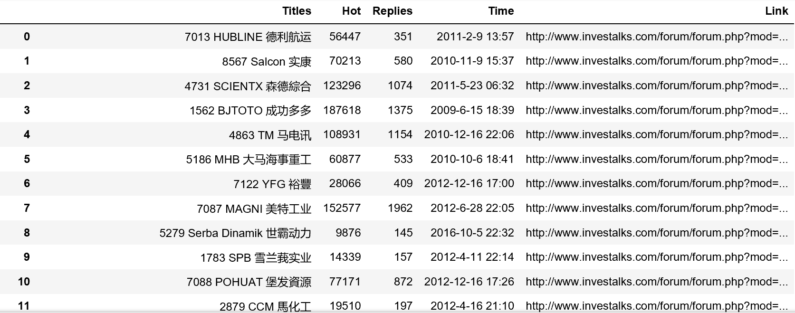
2
Milestone
MANAGEMENT OF DATA
News data
Forum data
https://www.klsescreener.com/v2/news
http://www.investalks.com/forum/forum.php?mod=forumdisplay&fid=7&typeid=17&filter=typeid&typeid=17&page=1

Slide 7
2
Milestone
MANAGEMENT OF DATA
Star schema
In the star schema, the Fact Table can be drill down to difference sources in difference dimension and each source (dimension) can roll up to the Fact Table using the ‘Stock Code’, and there are 5 dimension table.

Slide 8
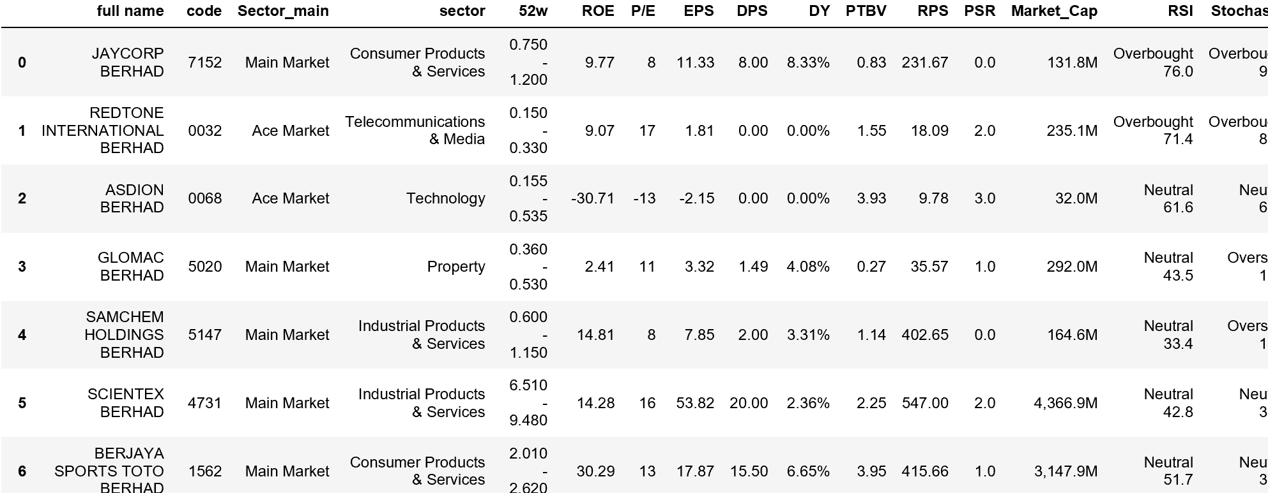
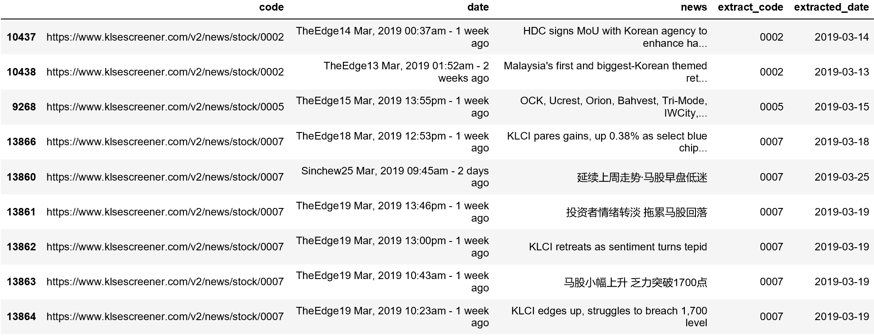
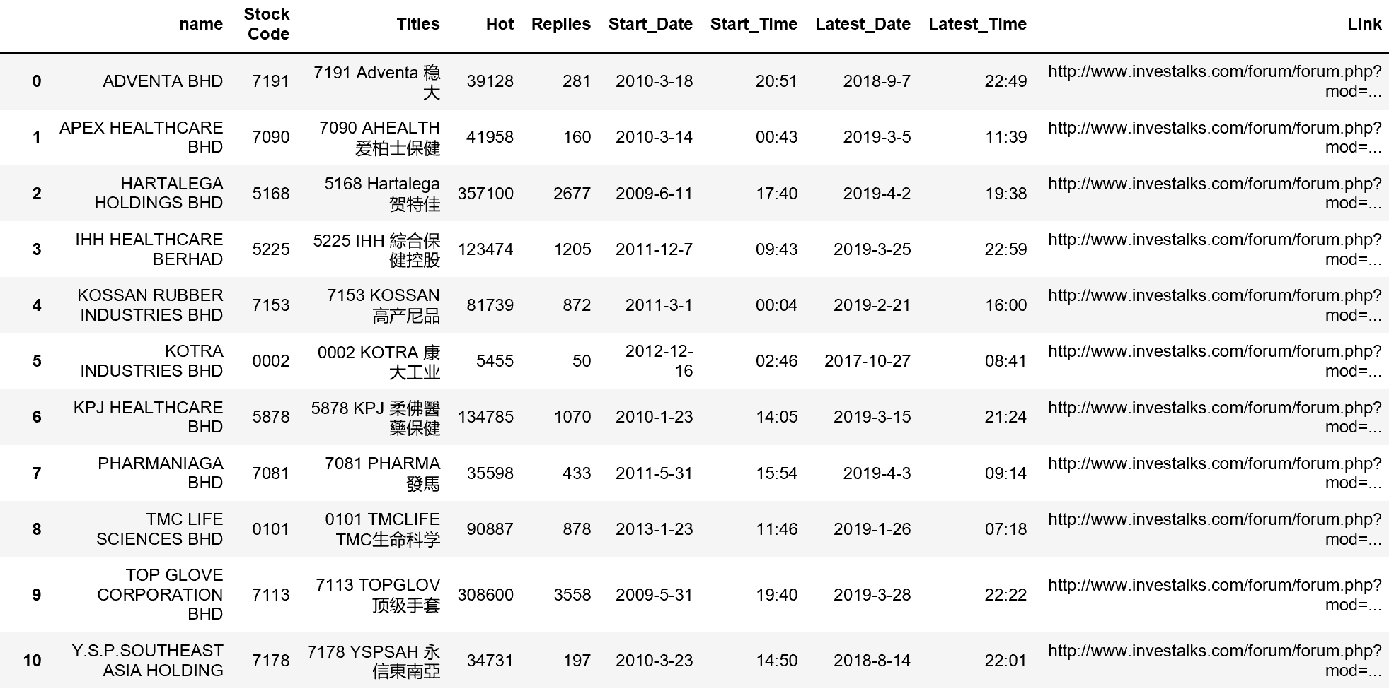
3
Milestone
PROCESSING OF DATA
Preprocessing of datasets
KLSE Financial data
News data
Forum data
The dataset is merge with the stock sector, and some changes is done, like add/drop variable, rearrange columns position, extract code from original column etc.
News data is crawled down once a week, and in the preprocess part, all the data is combined together, and the code and date is extracted to a separate column.
The forum data needs to extract the stock code from the title column, and then merge the stock name from other dataset.

Slide 9
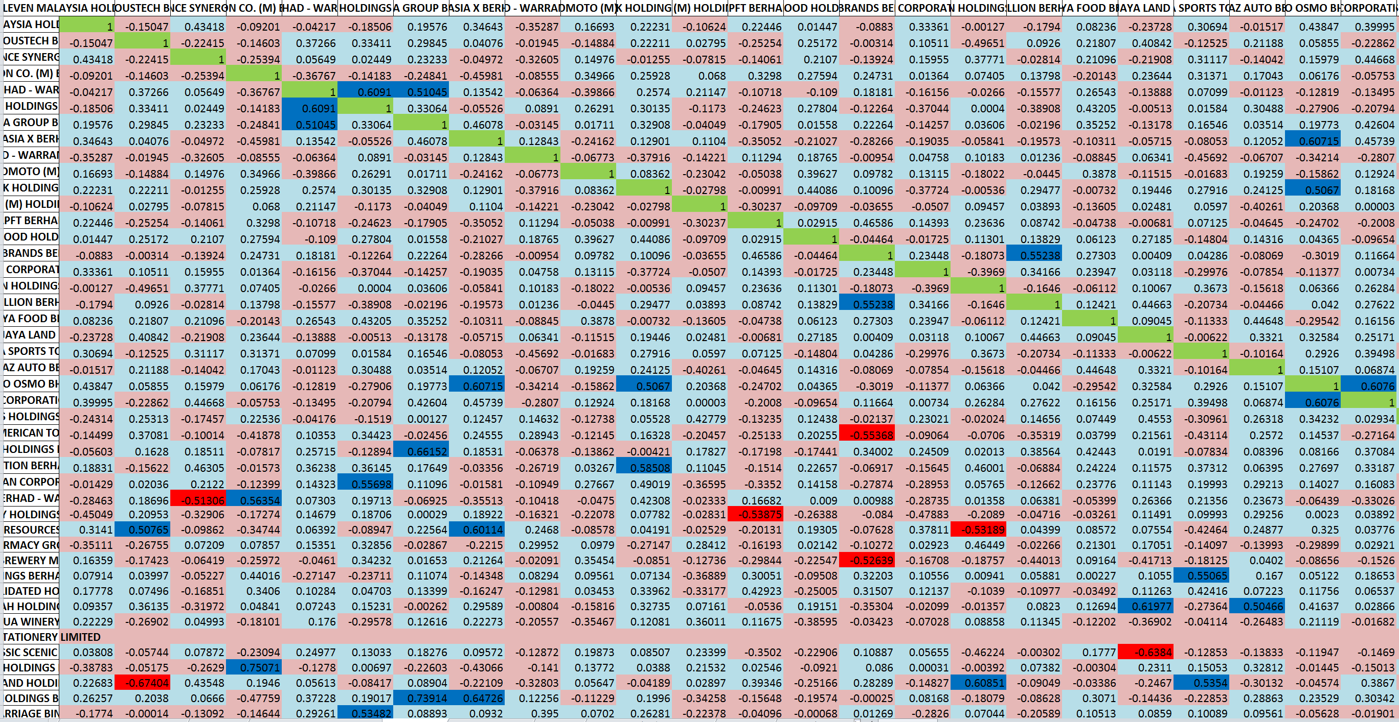
3
Milestone
PROCESSING OF DATA
Correlation of stocks
All the stock are filter by market and sector, and each of the sectors are saved to a separate file under the same market. Based on each sector of the same market, the pivot table is creating to see the relationship of each stock. Finally, the correlation of each stock is calculate and each level of correlation is highlight in excel file that shown below.

Slide 10
4
Milestone
INTERPRETATION OF DATA
Select stocks
Financial data
There are two sources relate to the financial report. One is used to calculate Debt Ratio. One is to select stocks.
The debt ratio is a financial ratio that measures the extent of a company's leverage. It can be interpreted as the proportion of a company's assets that are financed by debt.
The ROE, P/E, EPS, DPS, DY, RSI, and Stochastic variables are used to assess the stock performance.
(1) ROE stands for return on equity. It is a measure of how well a company uses investments to generate earnings growth, the higher the better.
(2) P/E stands for price to earnings ratio. It is used for valuing companies and to find out whether they are overvalued or undervalued. The lower the better, means with little money can earn big money.
(3) EPS stands for earning per share. The resulting number serves as an indicator of a company's profitability. The higher a company's EPS, the more profitable it is considered.
(4) DPS stands for dividend per share. It is the sum of declared dividends issued by a company for every ordinary share outstanding, the higher the better.
(5) DY stands for dividend yield. It shows what return expressed as dividends an investor will get per each dollar of his/her investment in company’s shares.
(6) RSI stands for Relative Strength Index. It is a momentum oscillator that measures the speed and change of price movements.
(7) Stochastic indicator shows us information about momentum and trend strength.

Slide 11
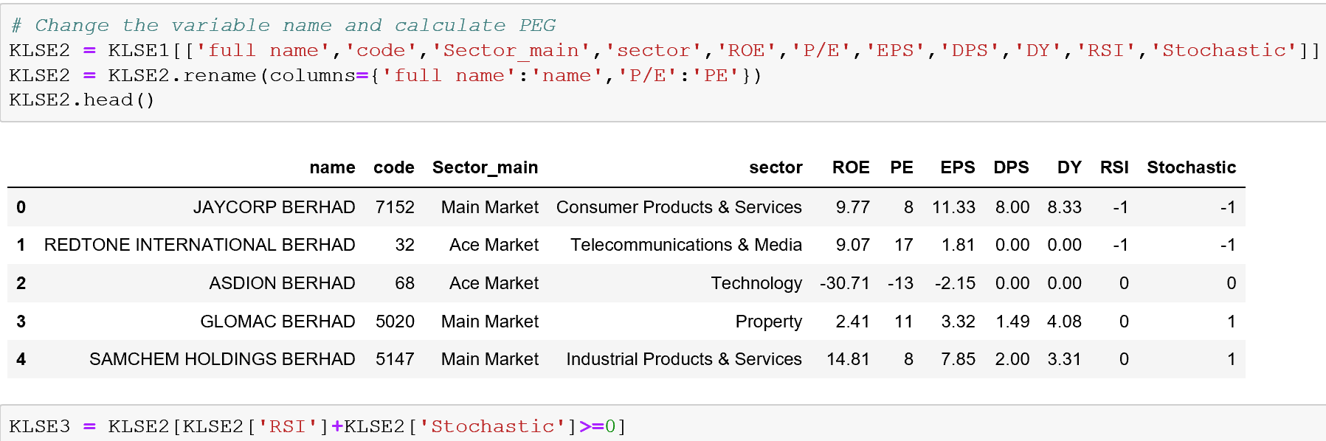
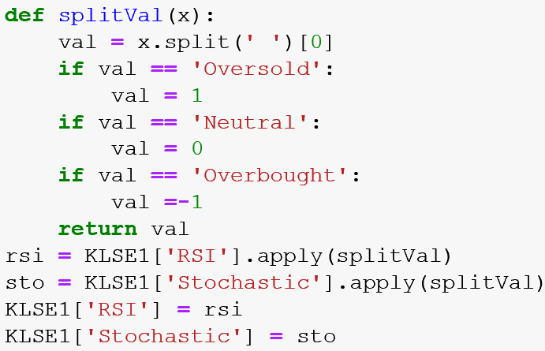
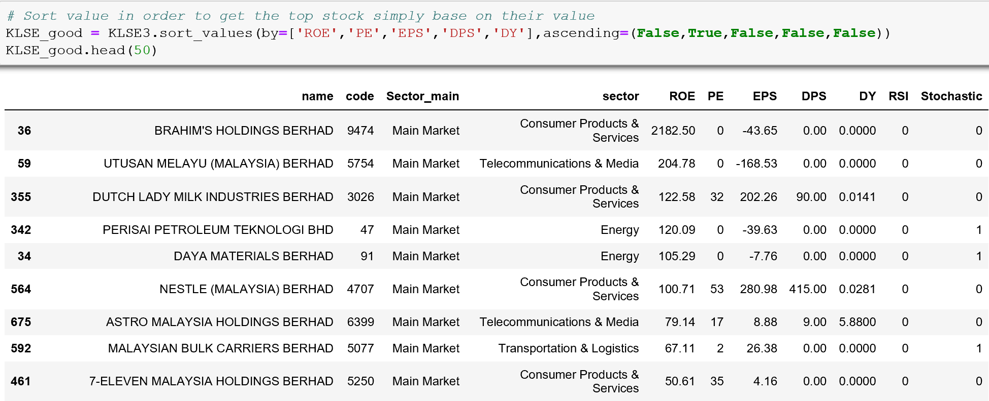
4
Milestone
INTERPRETATION OF DATA
The value “Oversold”, “Neutral”, “Overbought” in RSI and Stochastic are converted into number 1, 0, -1.
After that, sort the dataset in the order of higher ROE, lower PE, followed by higher EPS, DPS and DY to get the good stocks.

Slide 12
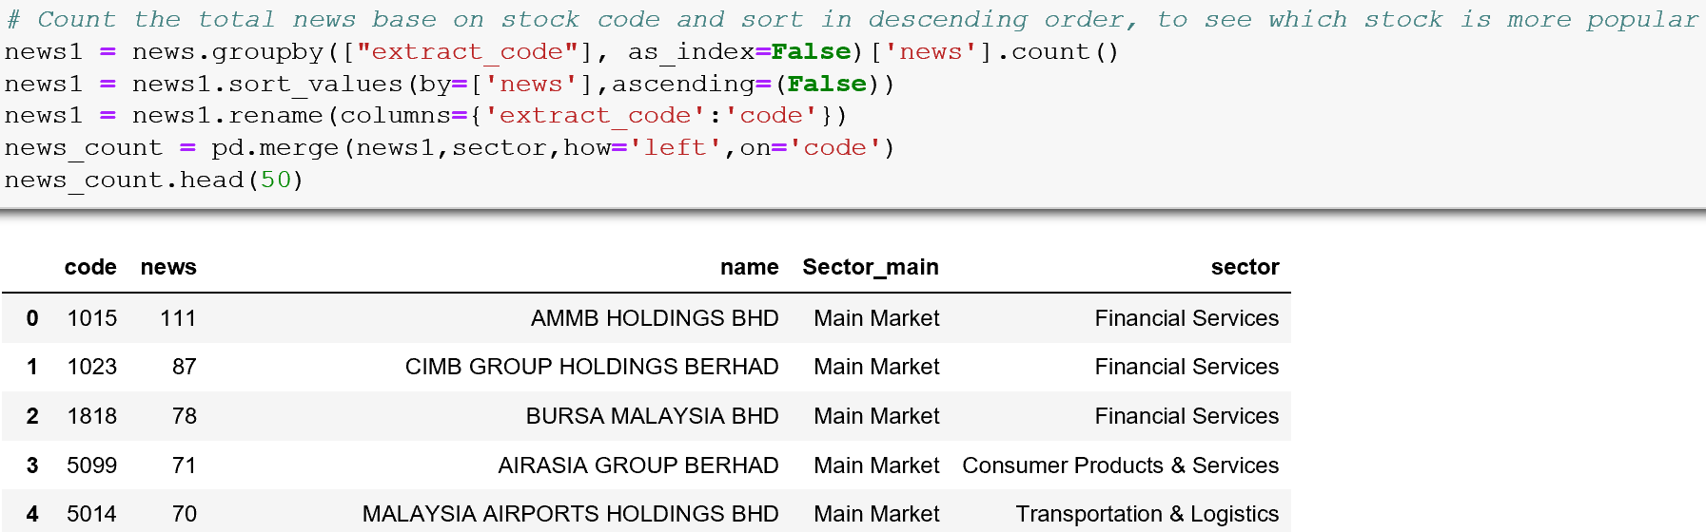
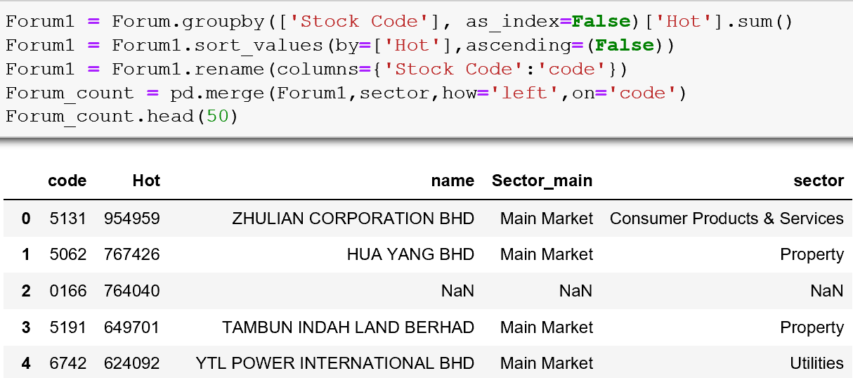
4
Milestone
INTERPRETATION OF DATA
Select stocks
News & Forum data
A stock’s performance is affected by the attention of investor. Generally, a stock with more news or comment means the stock is popular than others.
Thus, the news dataset is group by the stock code and get the count of each stock to see the number of news within this period of time. And the forum dataset is group by code then sum all the replay to get the rank of the stocks.

Slide 13
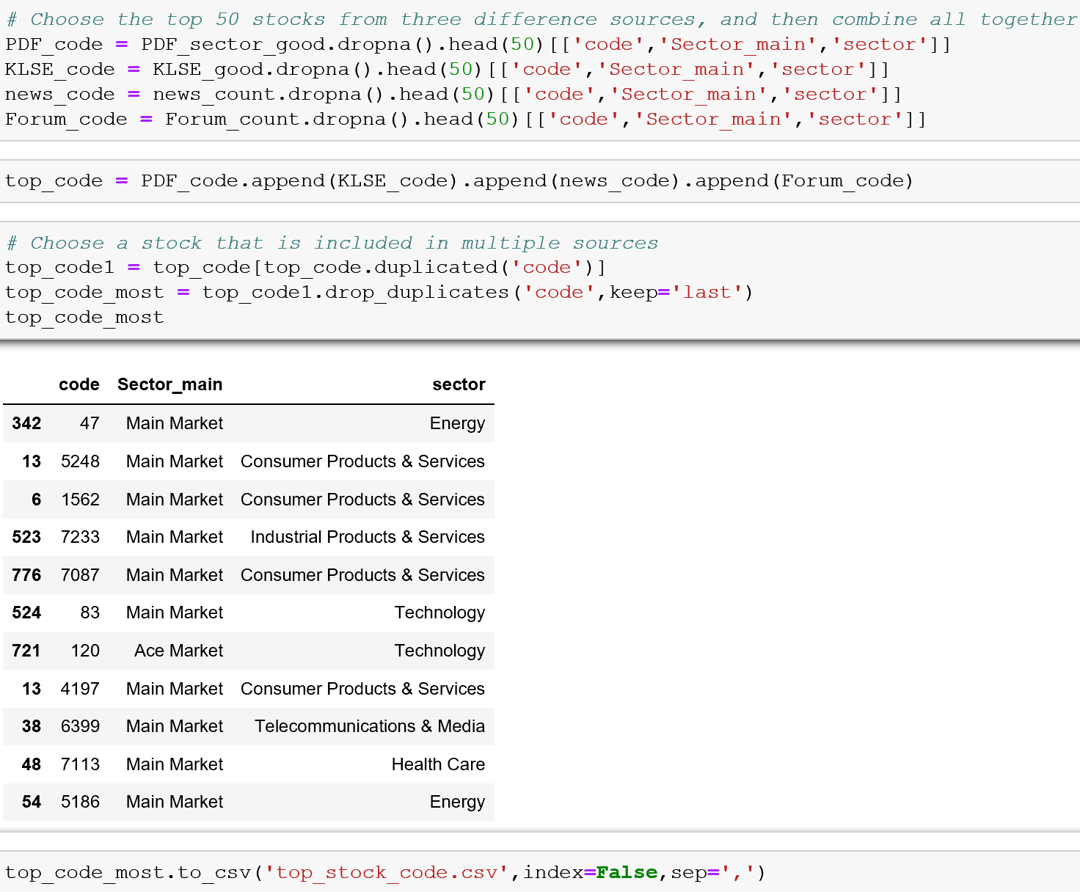
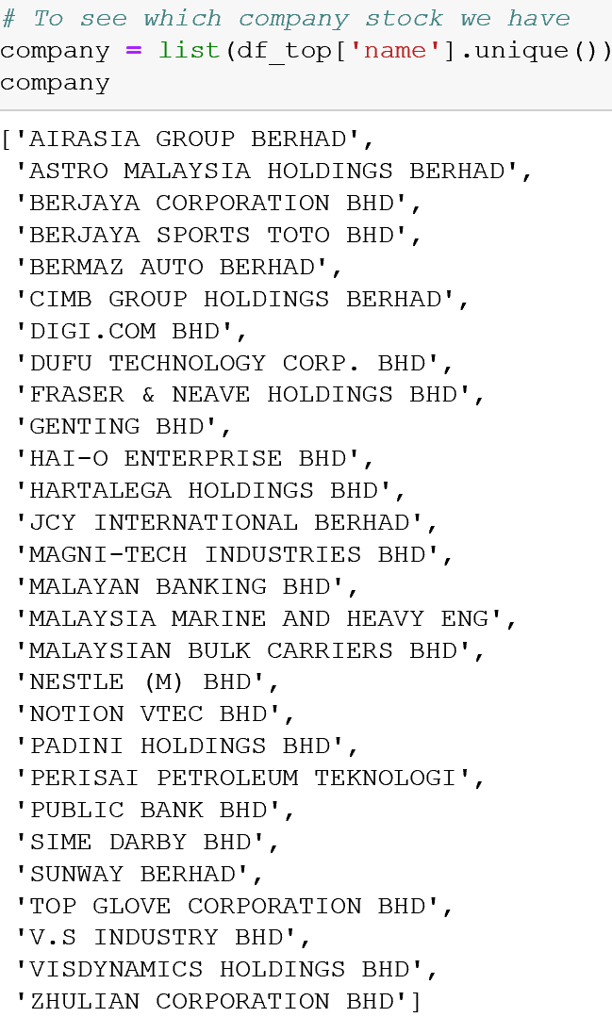
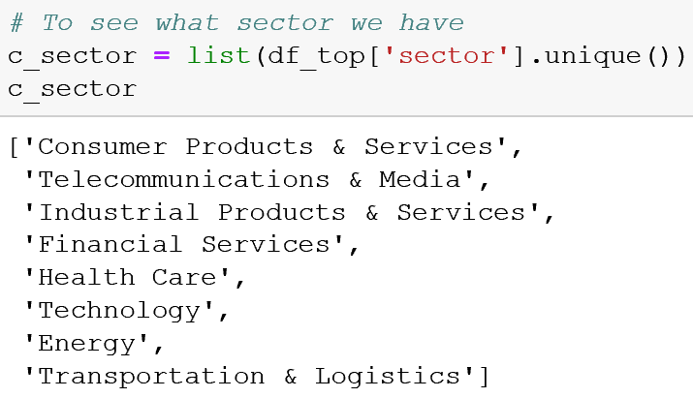
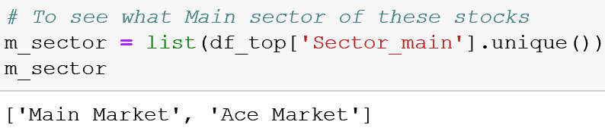
4
Milestone
INTERPRETATION OF DATA
Select stocks
Combining all those data set we can get the subset that choosing the top 50 stock from each dataset and then get the stock that is in two or more dataset as the final invest stock list and save as csv file.

Slide 14
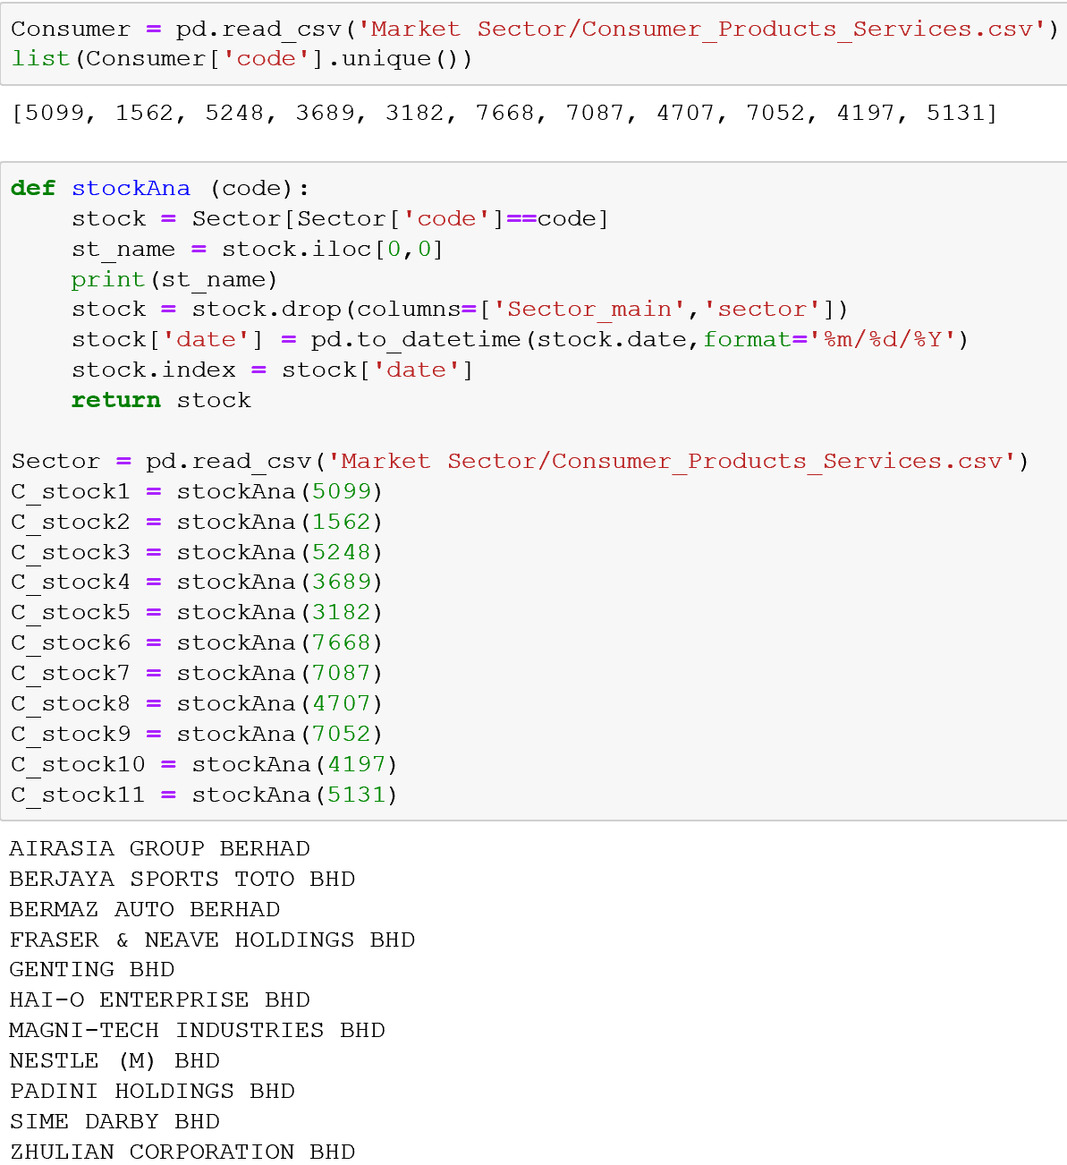
4
Milestone
INTERPRETATION OF DATA
Subset of stocks
After the selection of some good stock, the Consumer Products & Services sector has the most stocks.

Slide 15
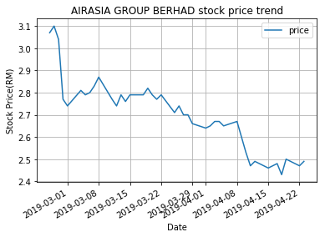
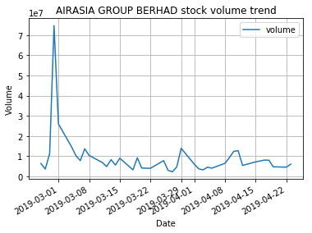
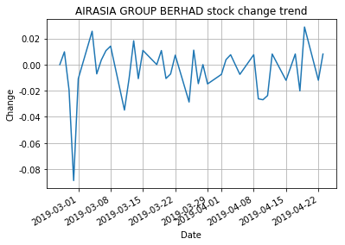
4
Milestone
INTERPRETATION OF DATA
Univariate analysis
The first stock in the list, AIRASIA GROUP BERHAD, is chosen for the analysis.

Slide 16
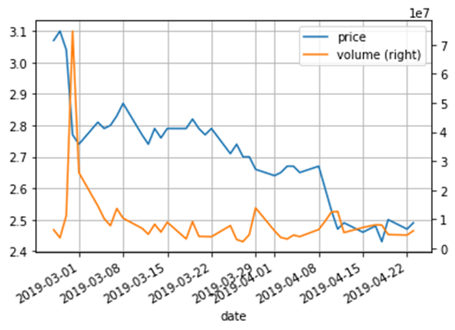
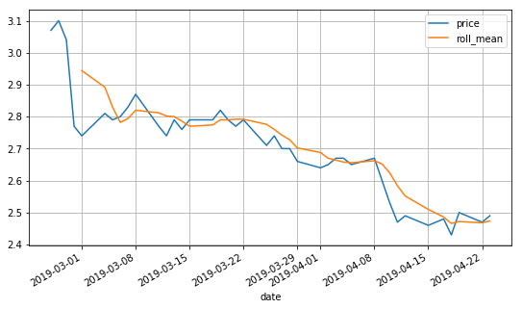
4
Milestone
INTERPRETATION OF DATA
Bivariate analysis
The left graph shows the smoother trend of price trend in the 5 days moving average and the price data. And the right graph shows the price data and the volume data.
We can see the volume goes down and the price also goes down, and vice versa, most of the time.

Slide 17
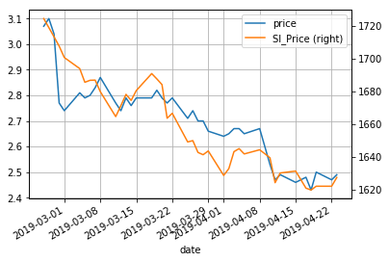
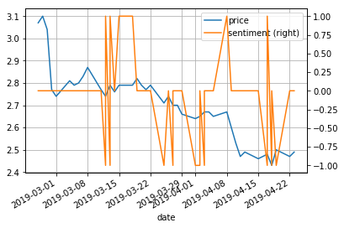
4
Milestone
INTERPRETATION OF DATA
Bivariate analysis
The left graph shows the Market index trend and the stock price trend. And the right graph shows the price and sentiment of the stock.
There are three types of sentiment, positive, neutral, and negative. Because no one stock can get news every day, so the day without the news data is label as neutral in the dataset, and the graph shows that positive news reflects on increasing price, and vice versa.

Slide 18
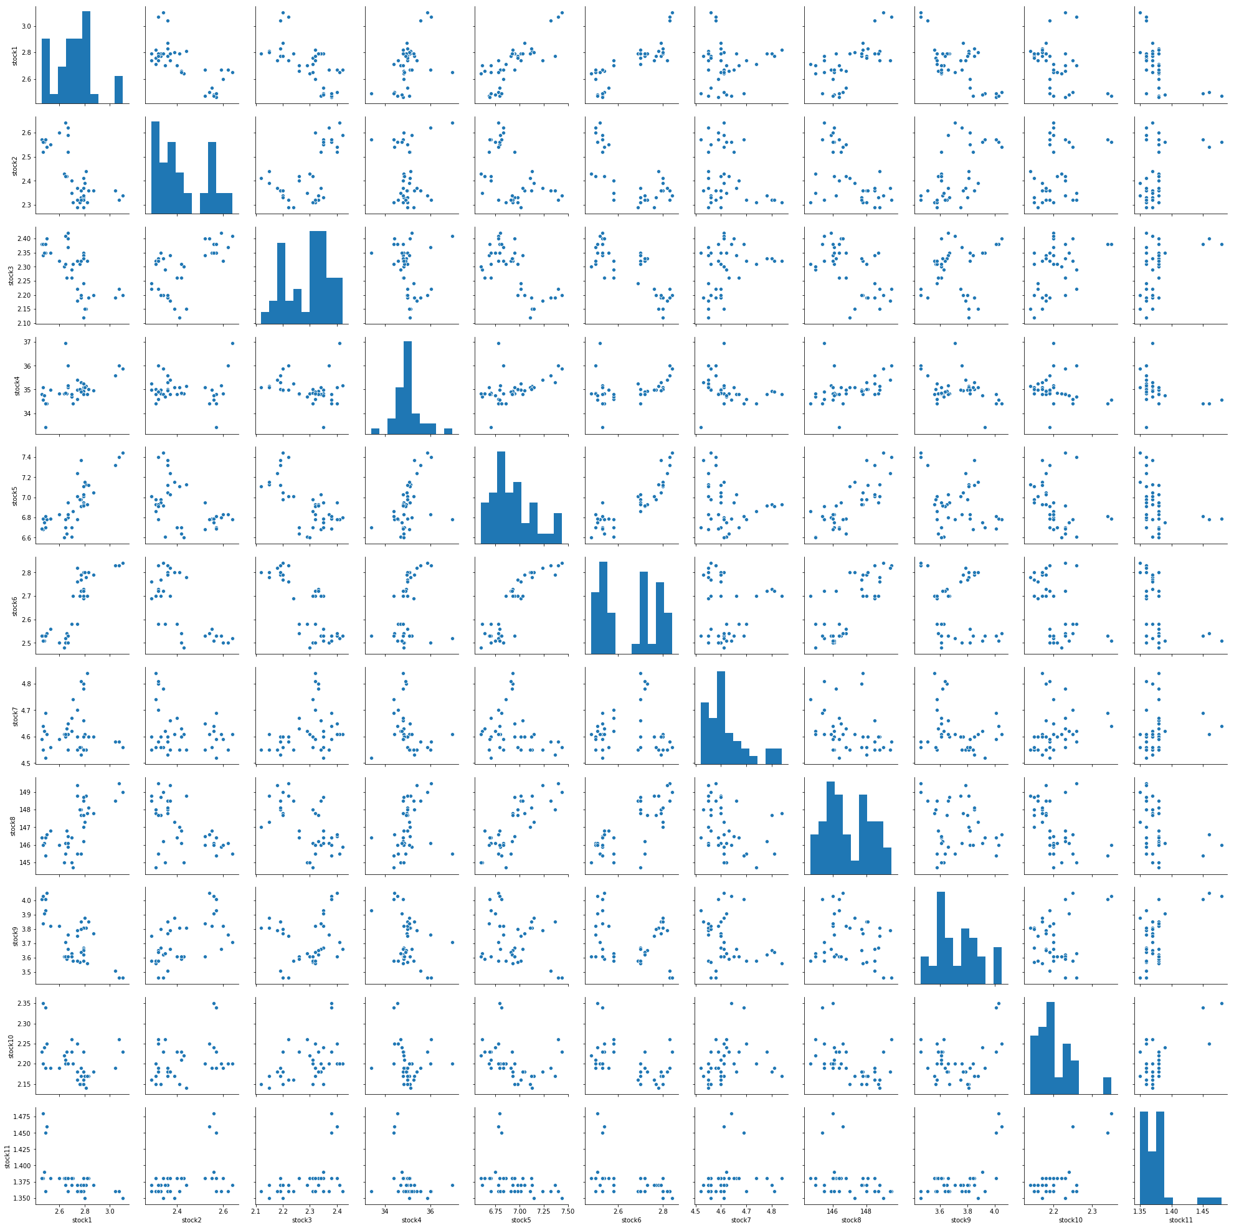
4
Milestone
INTERPRETATION OF DATA
Correlation analysis
The correlation within the 11 stocks in the Consumer Products & Services sector.
We can see from the correlation graph that stock 1, stock 5, stock 6 and stock 8 have a positive correlation, while stock 11 has no correlation among these stocks.
Using the SAX to convert the time series data into different symbol. With the result of transformation, stock 1, stock 5, stock 6 and stock 8 have same pattern.
These 4 stocks are positive correlate and when one stock’s price goes up, other stocks will likely to go up as well. Thus the 4 stocks are selected as the stock portfolio and label them to prepare for modeling.

Slide 19
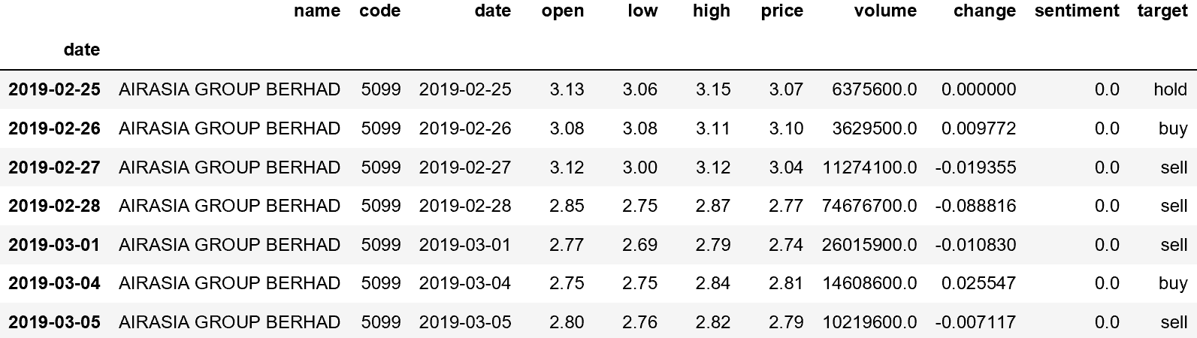
4
Milestone
INTERPRETATION OF DATA
Stock list
Based on the percentage of price change and sentiment score in the dataset to label the day of the stock that is buy, hold, or sell.

Slide 20
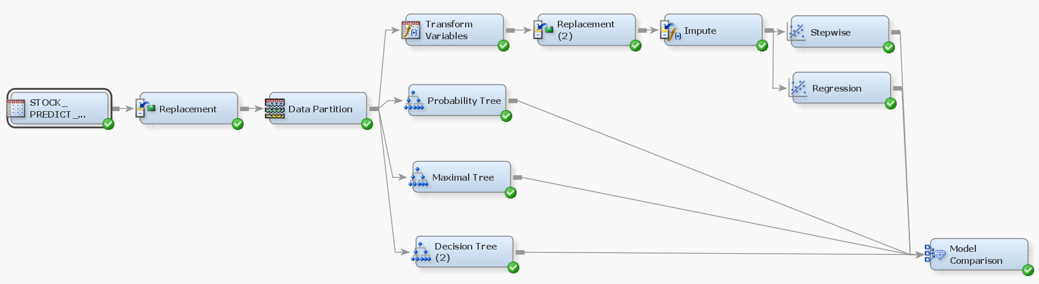
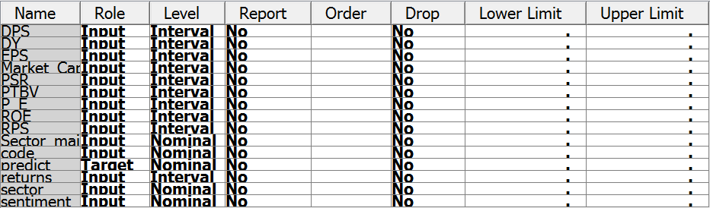
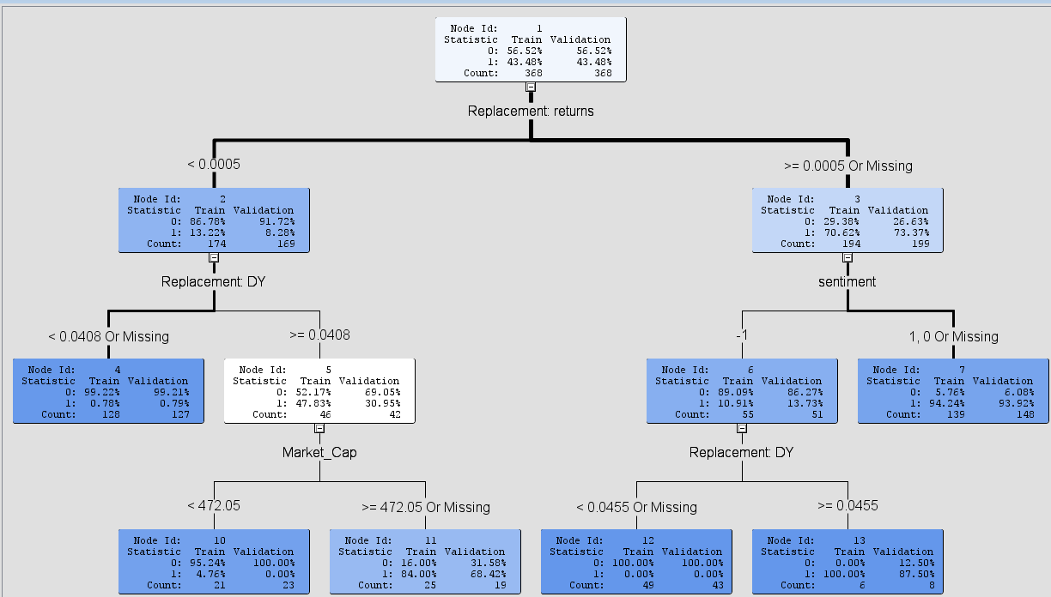
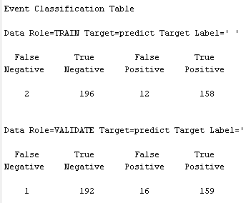
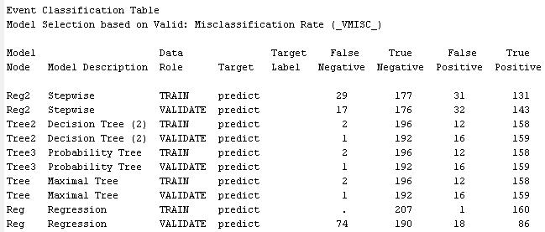
5
Milestone
COMMUNICATION OF INSIGHTS OF DATA
Selection model
With the Decision Tree model result shows, the ‘returns’ variable has the highest information gain, follow by ‘sentiment’ variable. And the output shows 96% accuracy. In the model comparison, the output shows that the decision tree model is better than the regression model.

Slide 21
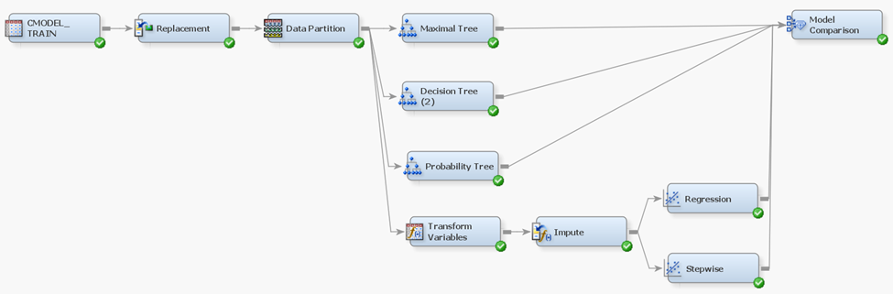
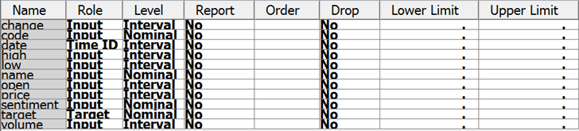
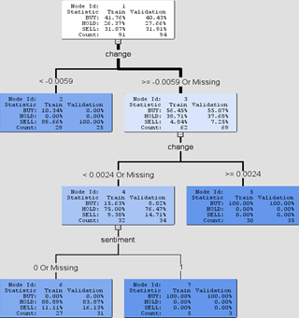
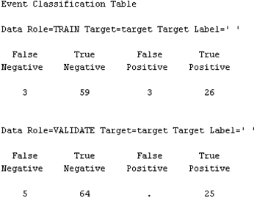
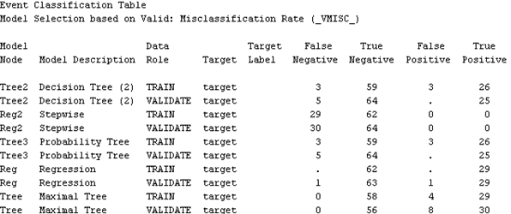
5
Milestone
COMMUNICATION OF INSIGHTS OF DATA
Prediction model
The dataset contains 11 columns and 4 stocks. Decision tree model shows the ‘change’ variable has the highest information gain, and that decide the split of the tree, and sentiment is less important in the dataset. The output of the decision tree model has 93% accuracy.

Slide 22
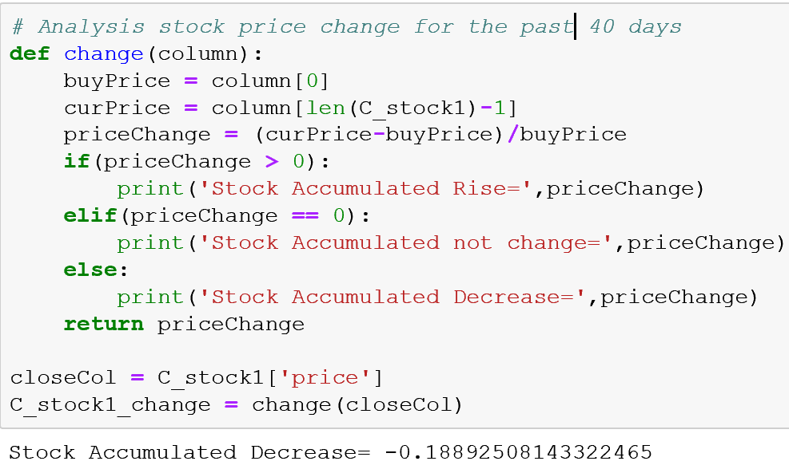
6
Milestone
PROVIDE RECOMMENDATIONS
There are around 40 days of record of each stock in the dataset, assume that we have brought the stock AIRASIA GROUP BERHAD in the first day, we can calculate the change from day one till day 40.
We can see that AIRASIA GROUP BERHAD stock price has decrease 19% compare to the first day and the visualization also indicate the same trend of the stock.
By analyzing such a stock in this way, it can be extended to multiple stocks for analysis and comparison.
First, the user can understand the real situation of the market, select a stock of a sector to invest, and compare the same sector to select a stock that is more worthy of investment. With those indicators, a user can choose their own stock portfolio and then decide whether to buy or hold or sell of the stock.

Slide 23
6
Milestone
PROVIDE RECOMMENDATIONS
The steps of investment in this project consist mainly 3 parts
(1) Understand industry trends
Use news data and forum data to find the hottest stocks, and to sort and find the most popular industries amount all the sectors.
(2) Selecting the leading stocks in the industry
Use stock indicators such as ROE, PE, EPS, DPS, DY, RSI, Sentiment, etc. to screen out better stocks for analysis.
(3) Specific analysis of stocks
By looking at the timing diagram of the variables and the candlestick chart, the overall trend of the stock is obtained, the profit and loss indicator is defined, and the data is labeled, respectively, buy, hold, and sell.

Slide 24
6
Milestone
PROVIDE RECOMMENDATIONS
Conclusion
In stock market, there are lots of information needs to consider before taking action. That means if we are about to analysis the stock market, the thing we need first is the data that is complete and useful.
However, the data sources in this report are simple and not big enough, and the results cannot be use in real investment.
There are still large spaces to enhance this project, the data, the model, the strategy and so on. But some process of the project is similar to the investment process.

Slide 25
2019·05
Thank You

